Slide 1

SHOP MANAGEMENT SYSTEM
“FROM CODE TO CONVENIENCE – A SMART BILLING SOLUTION
BY Harshvardhan (25BCG10017)

Slide 2


INTRODUCTION
Topic: Shop Management System
Language: Python
Goal: Build a digital billing system to manage
items, calculate totals, and save bills automatically.

Slide 3

OBJECTIVE
To create a digital billing system that helps shopkeepers manage sales easily and accurately using Python.
Our specific objectives are:
1️⃣ To take item details like name, quantity, and price from the user.
2️⃣ To calculate the total and grand total automatically.
3️⃣ To display a well-formatted final bill for the customer.
4️⃣ To save the bill with the current date and time in a text file.
5️⃣ To make the billing process faster, easier, and paperless.

Slide 4
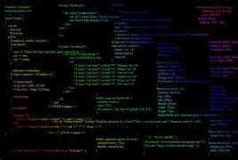
TOOLS AND TECHNOLOGIES USED
Programming Language:
3. built-in functions (Python core)
These are part of Python’s default libraries, no installation needed.Used throughout the program:
input() → to take data from user print() → to display output
open() → to create & write to text files sum() → to calculate total amount
Python 3 → main language used to develop the system
⚙️ Modules / Libraries Used
1. os Module
Used for folder and file management.(os.makedirs("bills", exist_ok=True)
2. datetime Module
Used to add date and time in the bill. Function used: datetime.now()

Slide 5
1.Input Number of Items
The user enters how many items they want to add.
→ For each item, the program asks for:
  Item Name
  Quantity
  Price per Item
2. Enter Item Details
WORKING PROCESS (FLOW OF PROGRAM)
3️⃣ Calculate Total
The total for each item = Quantity × Price
4️⃣ Display Final Bill
The program prints all items in a table with totals and grand total.
5️⃣ Save the Bill
→ The final bill is saved automatically in a folder named “bills”
→ The file name contains the current date and time.

Slide 6



start
FLOW CHART
input number of items
more
no
items to input?
input details for item
display final bill
save bill with date and time
end

Slide 7
ALGORITHM
5. Compute grand_total as sum of totals.
6. Display formatted bill with item rows and grand_total.
7. Create folder bills (if not exists).
8. Create filename with current date & time and save bill to that file.
9. End program.
1. Start program.
2. Ask user for number of items n.
3. Initialize empty lists: items, quantities, prices, totals.
4. For i from 1 to n:
  Read name, qty, price.
  Compute total = qty * price.
  Append name to items, qty to quantities, price to prices, total to totals.

Slide 8
Pseudocode
START
INPUT n
items = []; quantities = []; prices = []; totals = []
FOR i = 1 TO n:
INPUT name
INPUT qty
INPUT price
total = qty * price
APPEND name TO items
APPEND qty TO quantities
APPEND price TO prices
APPEND total TO totals
END FOR
grand_total = SUM(totals)
DISPLAY header
FOR each index i in 0..n-1:
DISPLAY items[i], quantities[i], prices[i], totals[i]
END FOR
DISPLAY "Grand Total =", grand_total
IF folder "bills" DOES NOT EXIST:
CREATE folder "bills"
END IF
timestamp = CURRENT_DATETIME()
filename = "bills/bill_" + timestamp + ".txt"
SAVE bill content TO filename
END

Slide 9
Python Code (Main Logic)
def format_currency(x):
return f"₹ {x:,.2f}"
def main():
print("===================================")
print(" SHOP MANAGEMENT SYSTEM ")
print("===================================")
# Step 1: Number of items
n = safe_int("Enter number of items: ")
if n == 0:
print("No items entered. Exiting.")
return
items = []
quantities = []
prices = []
totals = []
# Step 2: Input for each item with validation
for i in range(n):
print(f"\nEnter details for Item {i+1}:")
name = input("Item name: ").strip()
if not name:
name = f"Item_{i+1}"
qty = safe_int("Quantity: ")
import os
from datetime import datetime
def safe_int(prompt):
while True:
try:
v = int(input(prompt))
if v < 0:
print("Please enter a non-negative integer.")
continue
return v
except ValueError:
print("Invalid input. Please enter an integer.")
def safe_float(prompt):
while True:
try:
v = float(input(prompt))
if v < 0:
print("Please enter a non-negative number.")
continue
return v
except ValueError:
print("Invalid input. Please enter a number (e.g. 49.99).")

Slide 10
price = safe_float("Price per item: ")
total = qty * price
items.append(name)
quantities.append(qty)
prices.append(price)
totals.append(total)
# Step 3: Display final bill
print("\n-------------------------------------")
print(" FINAL BILL ")
print("-------------------------------------")
print(f"{'Item':<20}{'Qty':<8}{'Price':<12}{'Total':<12}")
print("-------------------------------------")
grand_total = 0.0
for i in range(n):
print(f"{items[i]:<20}{quantities[i]:<8}{prices[i]:<12.2f}{totals[i]:<12.2f}")
grand_total += totals[i]
print("-------------------------------------")
print(f"{'Grand Total':<40}{grand_total:>10.2f}")
print("-------------------------------------")
print("Thank you for shopping!")
# Step 4: Save bill in 'bills' folder with timestamp and date/time in content
folder = "bills"
try:
os.makedirs(folder, exist_ok=True)
except OSError as e:
print(f"Error creating folder '{folder}': {e}")
return
timestamp = datetime.now().strftime("%Y%m%d_%H%M%S")
filename = f"bill_{timestamp}.txt"
filepath = os.path.join(folder, filename)
try:
with open(filepath, "w", encoding="utf-8") as f:
f.write("===================================\n")
f.write(" SHOP MANAGEMENT SYSTEM \n")
f.write("===================================\n\n")
f.write(f"Date: {datetime.now().strftime('%Y-%m-%d %H:%M:%S')}\n\n")
f.write(f"{'Item':<20}{'Qty':<8}{'Price':<12}{'Total':<12}\n")
f.write("-----------------------------------\n")
for i in range(n):
f.write(f"{items[i]:<20}{quantities[i]:<8}{prices[i]:<12.2f}{totals[i]:<12.2f}\n")
f.write("-----------------------------------\n")
f.write(f"{'Grand Total':<40}{grand_total:>10.2f}\n")
f.write("-----------------------------------\n")
f.write("Thank you for shopping!\n")
print(f"\n Bill saved successfully inside '{folder}' as '{filename}'.")
print(f"Location: {os.path.abspath(filepath)}")
except OSError as e:
print(f"Error saving bill to '{filepath}': {e}")
if __name__ == "__main__":
main()

Slide 11
Input and Output
Input
Output
Enter number of items: 3
Item 1 name: Soap
Quantity: 4
Price per item: 25
Item 2 name: Oil
Quantity: 2
Price per item: 80
Item 3 name: Biscuit
Quantity: 5
Price per item: 10
-------------------------------------
FINAL BILL
-------------------------------------
Item Qty Price Total
-------------------------------------
Soap 4 25.00 100.00
Oil 2 80.00 160.00
Biscuit 5 10.00 50.00
-------------------------------------
Grand Total = ₹ 310.00
-------------------------------------
Thank you for shopping!

Slide 12
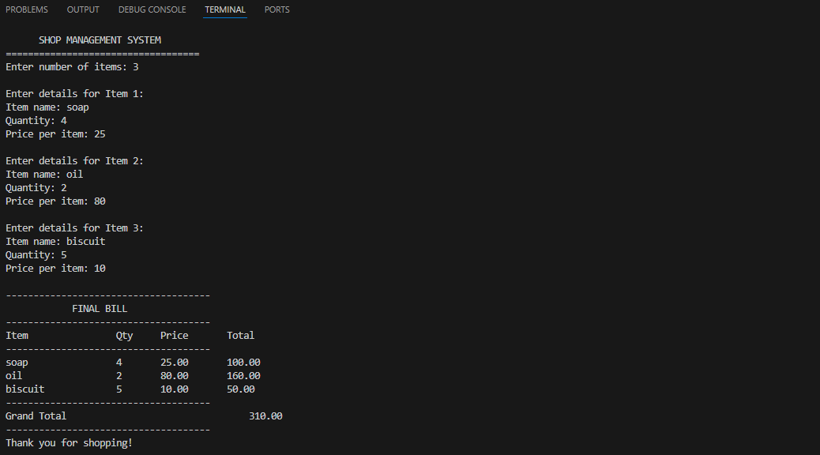
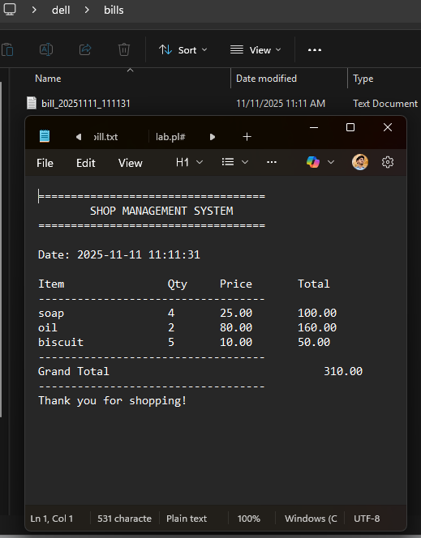
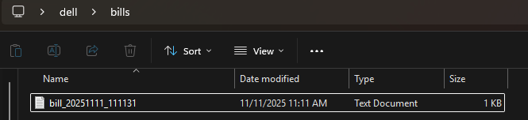
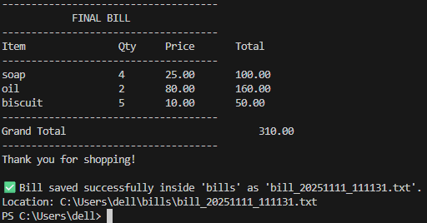
Terminal showing program run
File Explorer
open in Notepad

Slide 13

Features of the Project
✅ Automatically generates and saves bill files
✅ Each bill has unique timestamped name (no overwriting)
✅ Displays formatted final bill with totals
✅ Simple command-line interface (easy to use)
✅ Lightweight and runs on any system
Harshvardhan (25BCG10017)
Thank You

